Slide 1

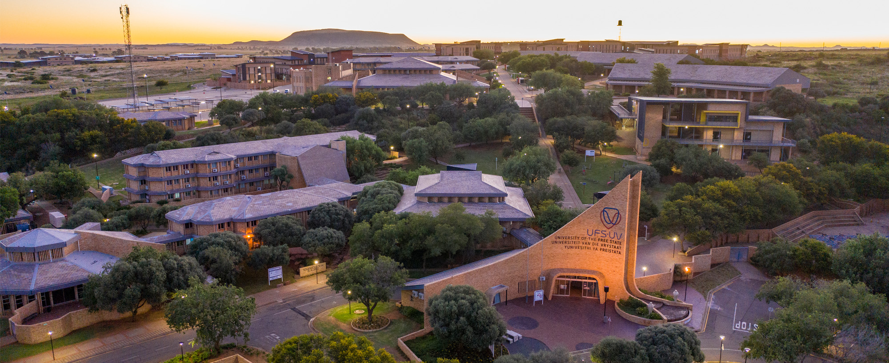


From Crisis to Capability: Building AI That Works Where It Matters Most for Learning
Moeketsi Mosia
A/Prof and ETDP-SETA Research Chair in Mathematics Education,
Vice-Dean: T&L
www.ufs.ac.za

Slide 2



Knowledge Project
Enabling opportunities to learning through
Data
Machine Learning (ML)
Artificial Intelligence (AI)
Leveraging vast datasets to personalize learning pathways and identify areas for improvement, ensuring targeted support.
Developing intelligent algorithms that adapt educational content, provide real-time feedback, and predict learning needs for individual students.
Building smart systems to automate assessment, offer personalized tutoring, and create dynamic, adaptive learning environments.

Slide 3
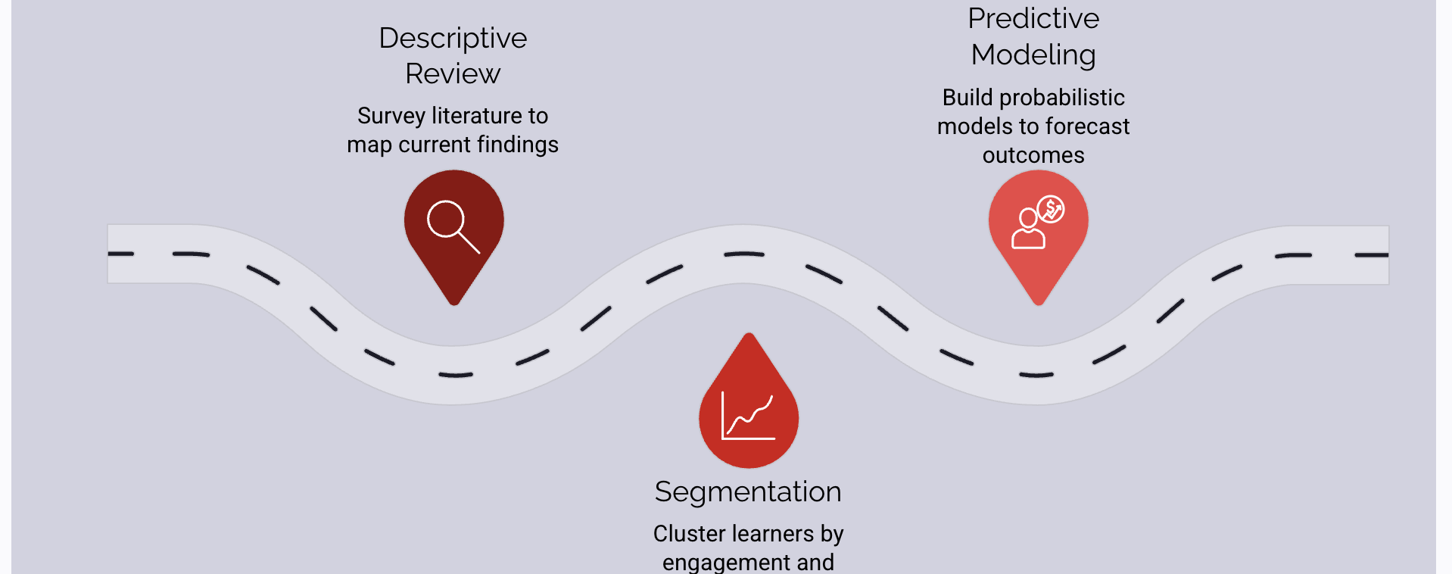
Our Journey

Slide 4
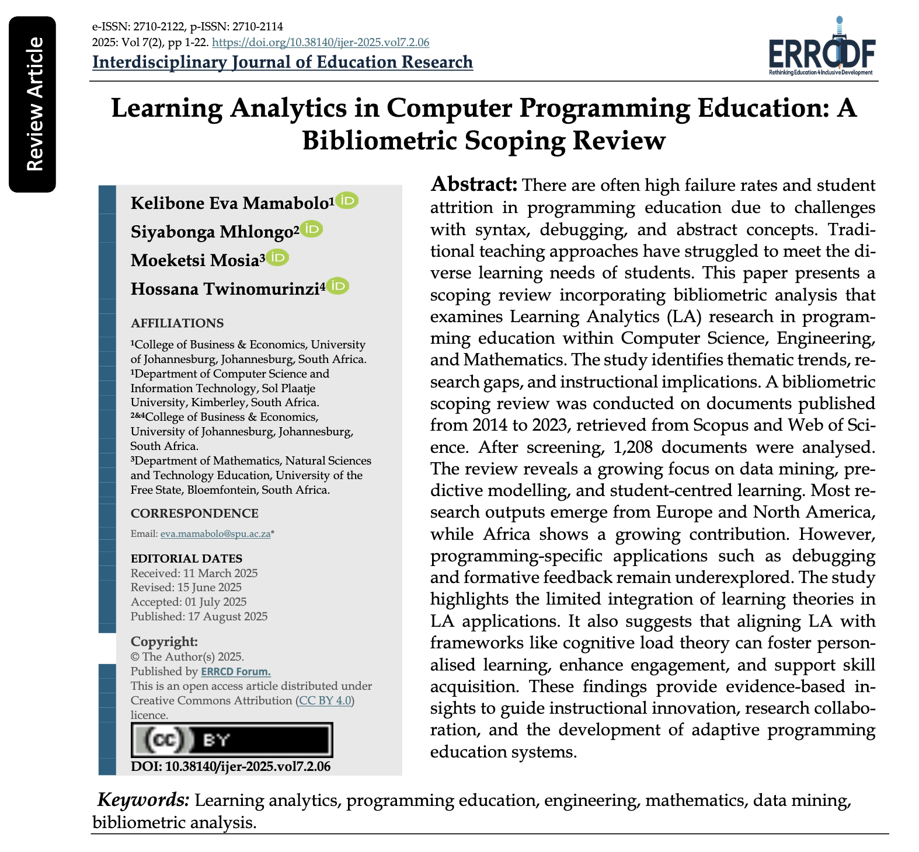
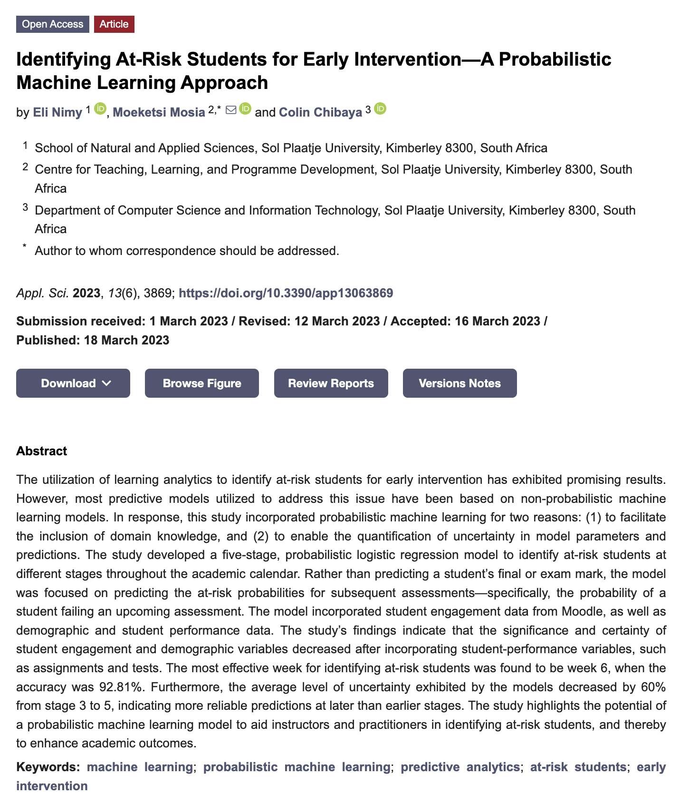

Slide 5
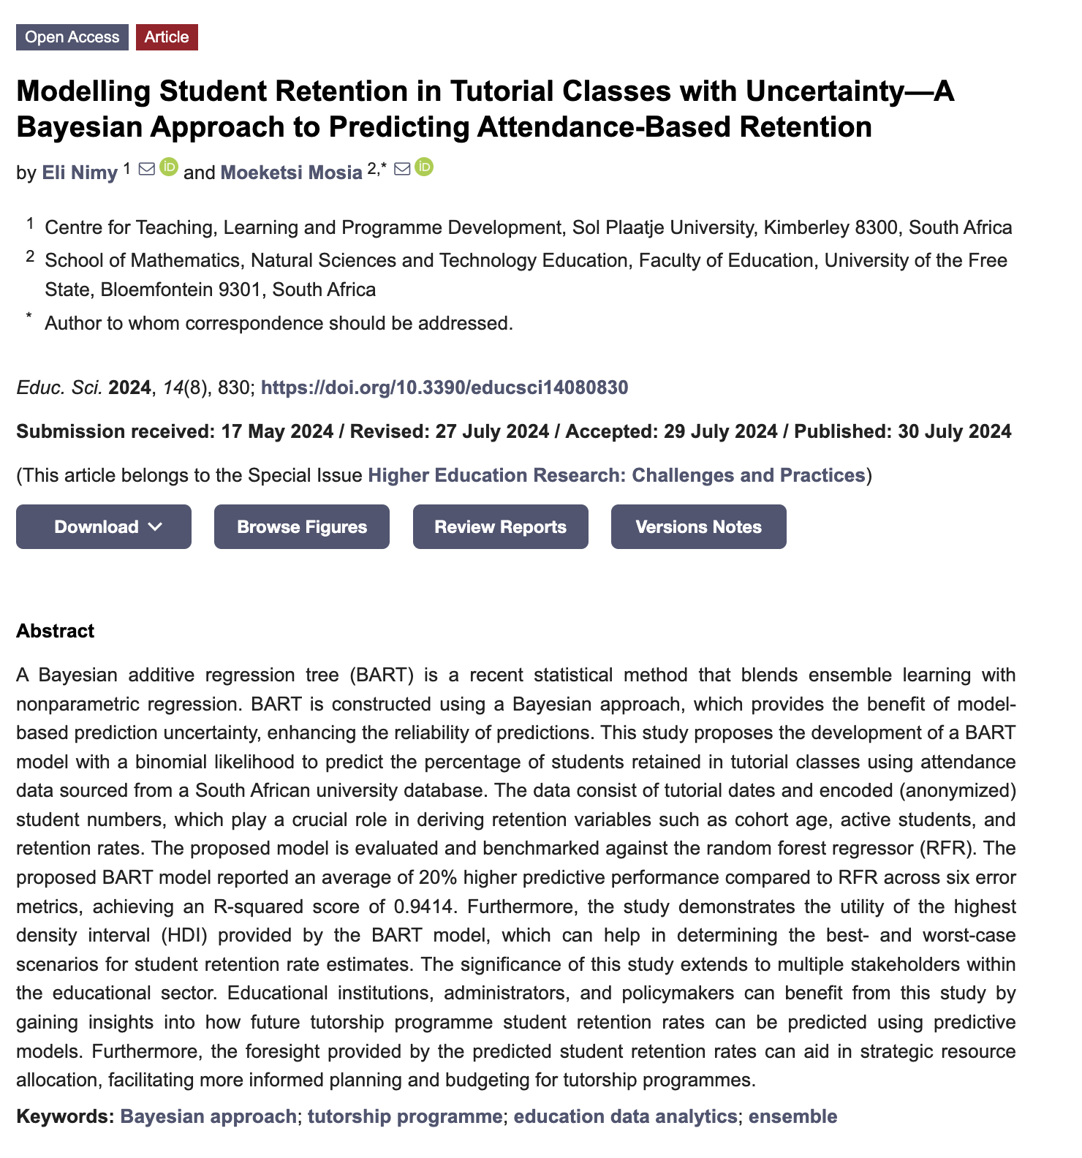
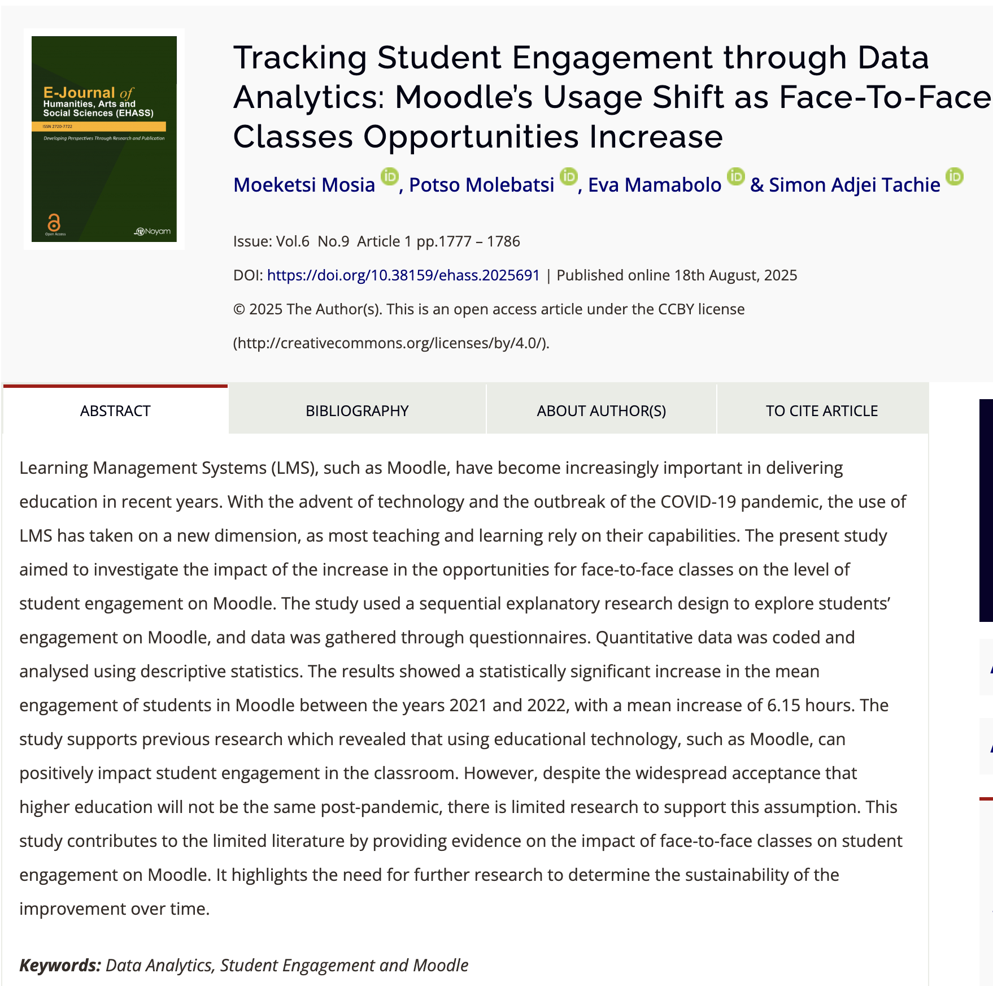

Slide 6
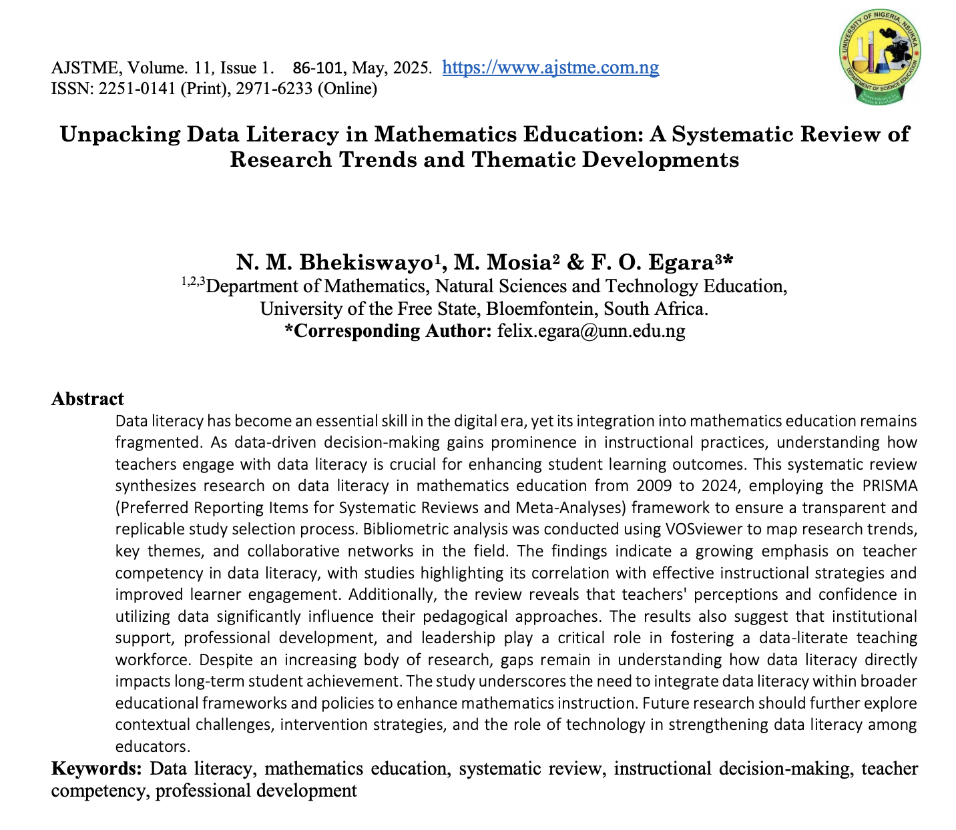
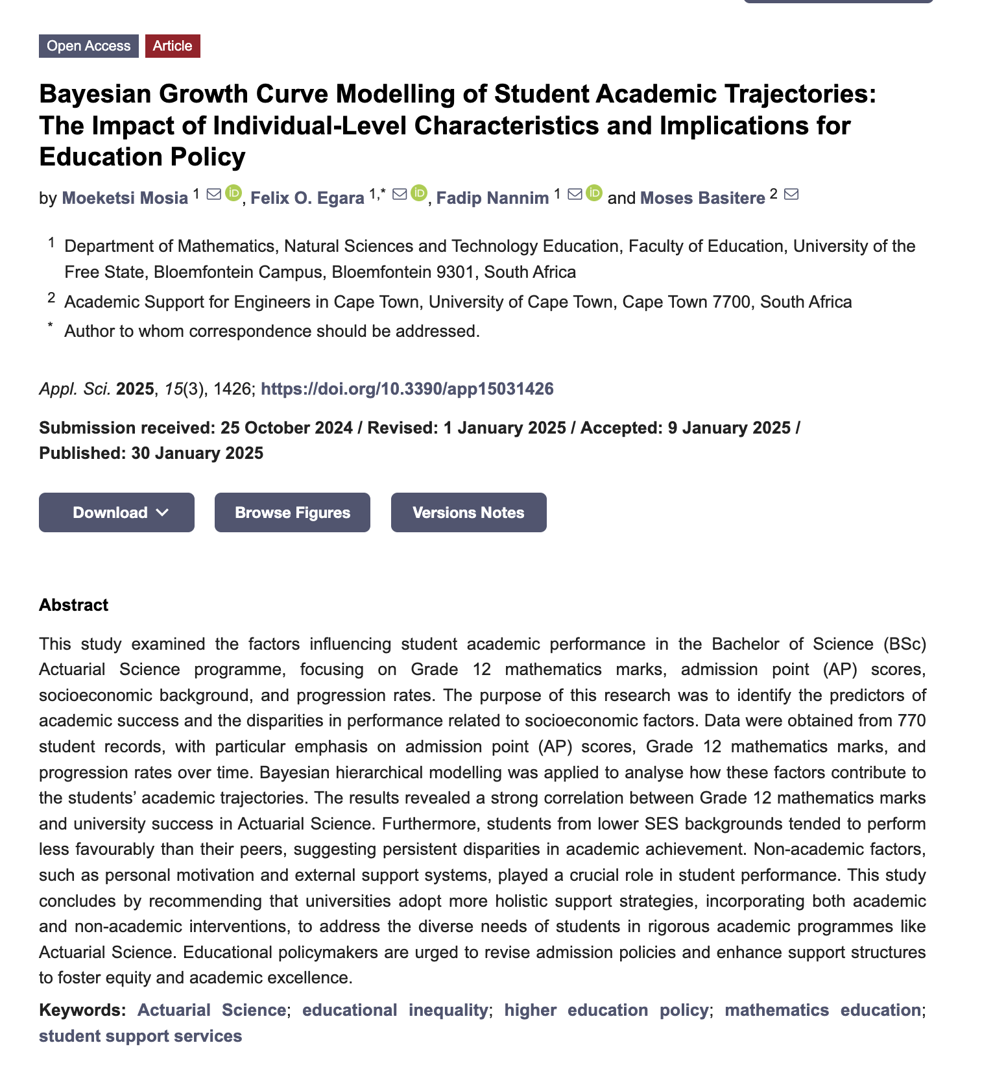

Slide 7
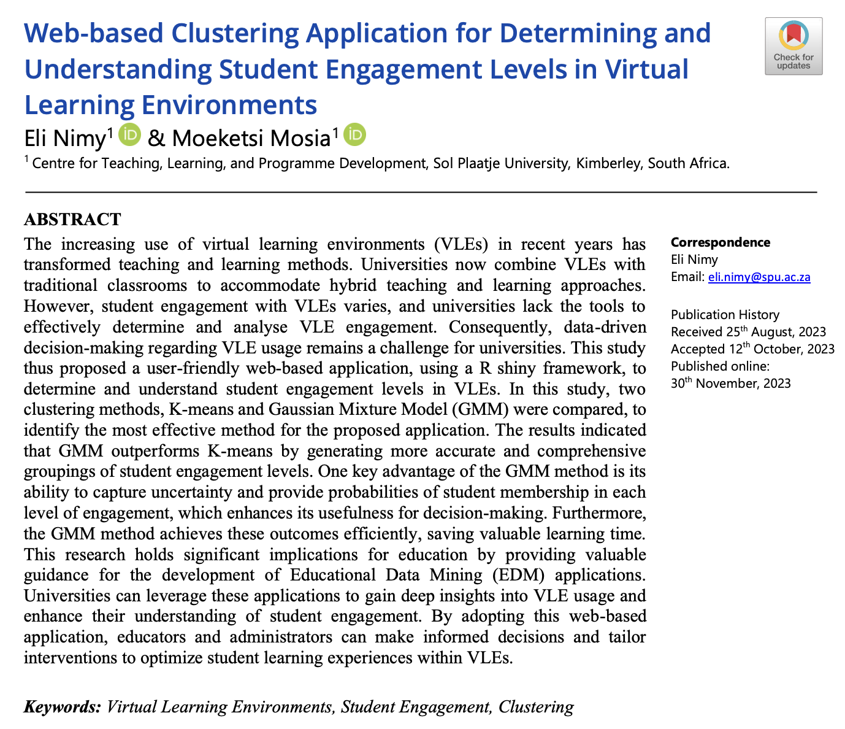
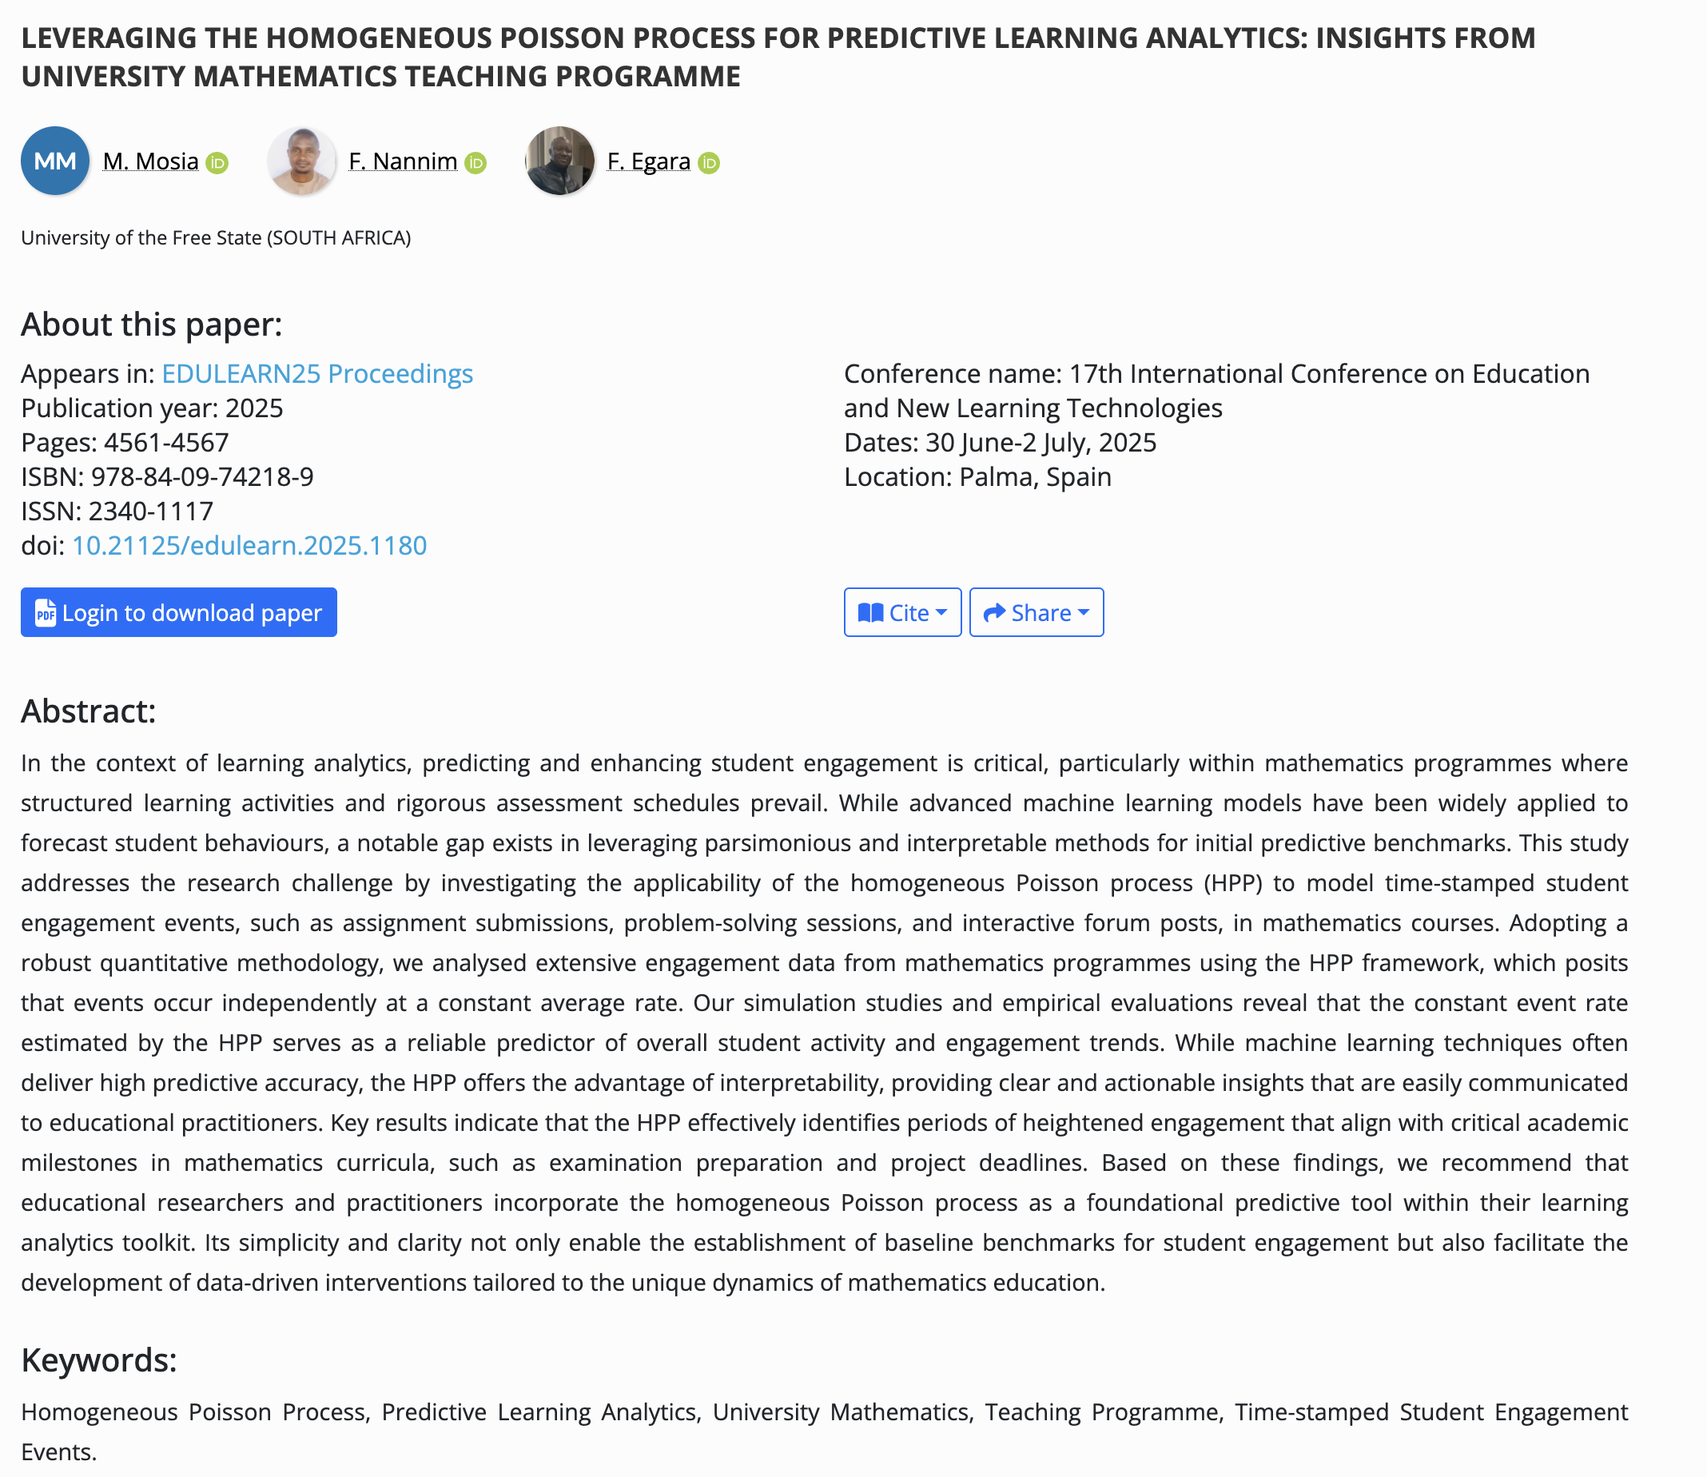

Slide 8
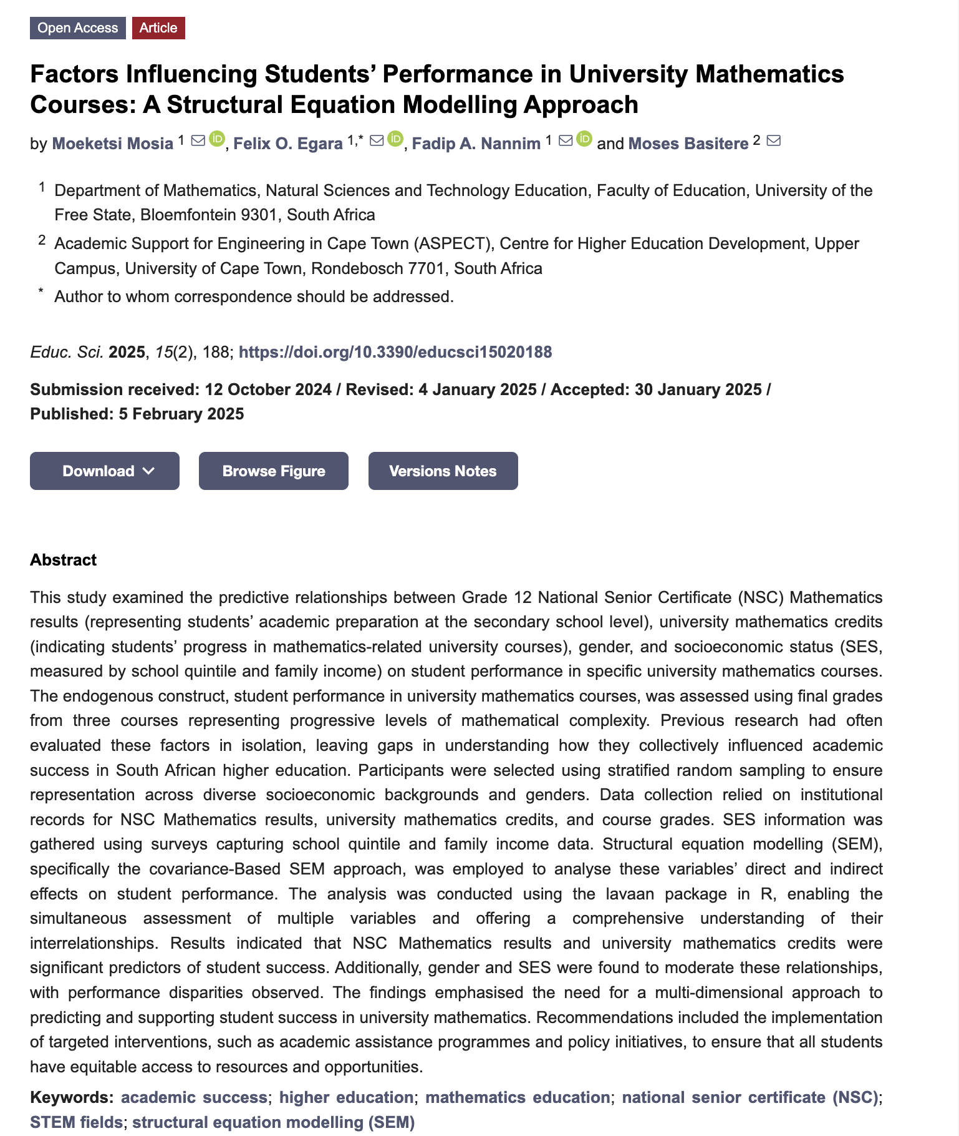
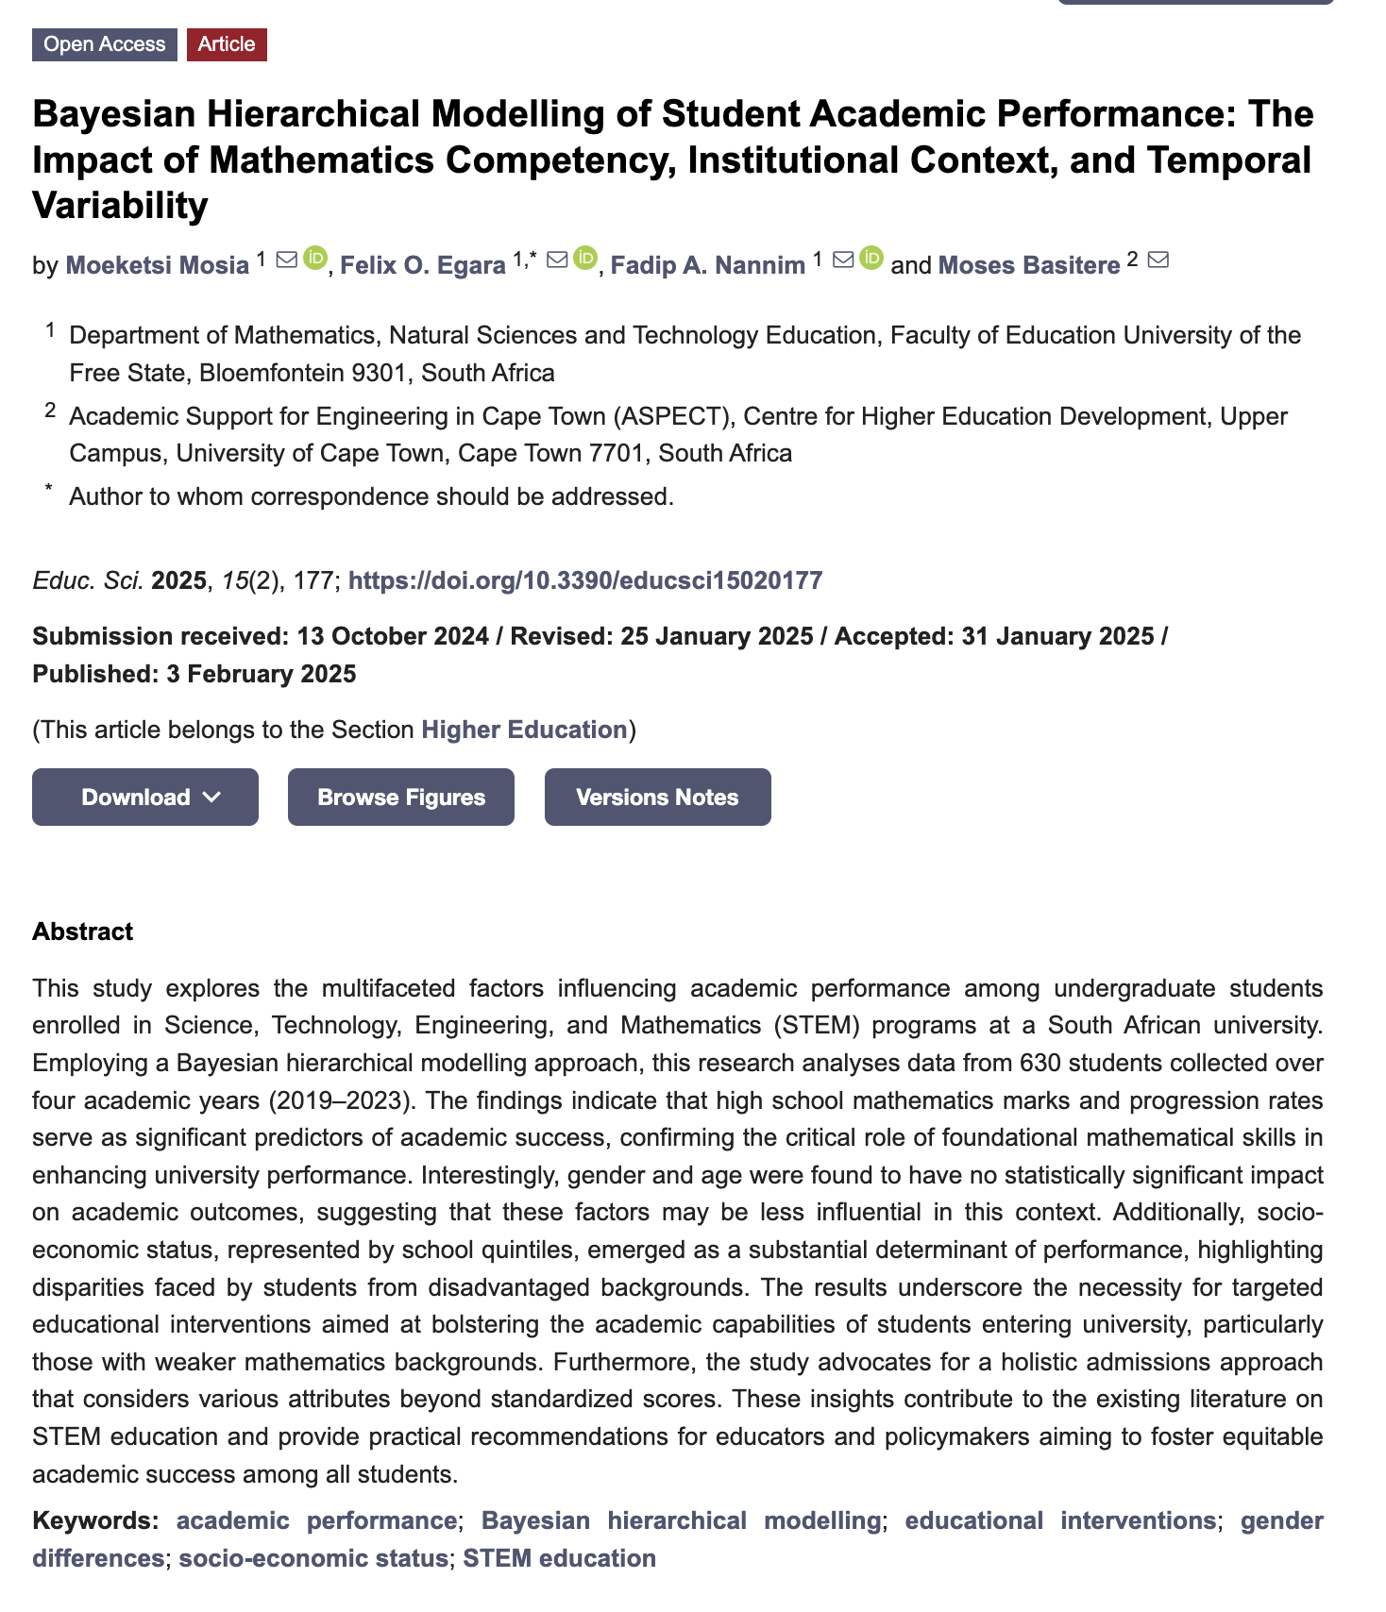

Slide 9
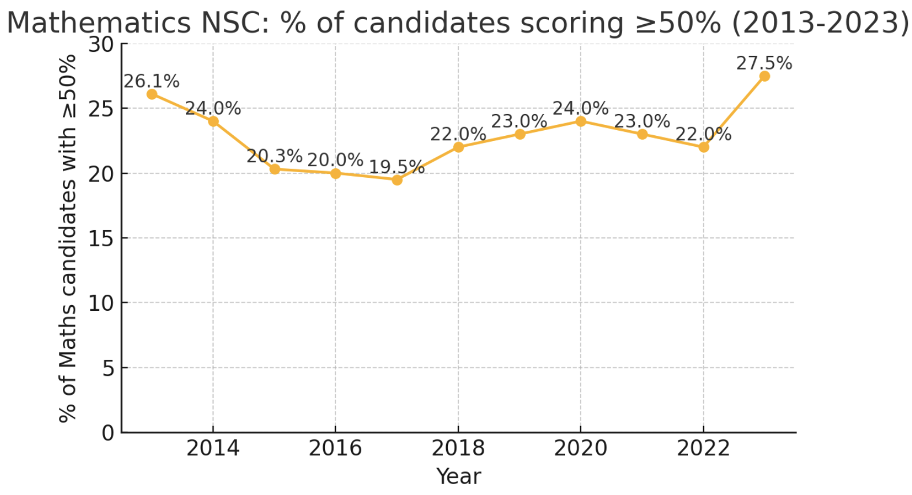
Why – we care Causal Analytics?

Slide 10

Tools - Why?
ML
Currently
Prediction = Model + Data
State of the world

Slide 11
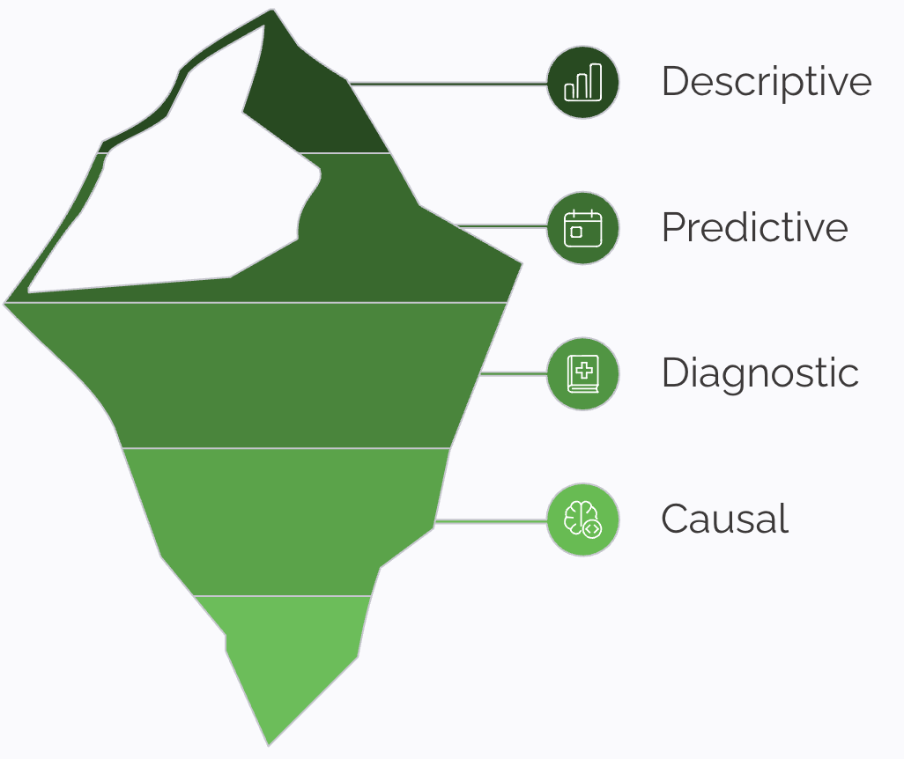
Why Learning Analytics Must Go Causal
Shows us what's happening and to whom/when
Step further by suggesting why performance patterns occur.(Including Prescriptive analytics)
Why did it happen?
What will cause improvement? (what works?)

Slide 12
Knowing that “students who Master A tend to do well on B” does not mean “teaching A will raise B.”
Gaps – Problem Statement
Students who completed a bridging course performed better in first-year STEM

Slide 13
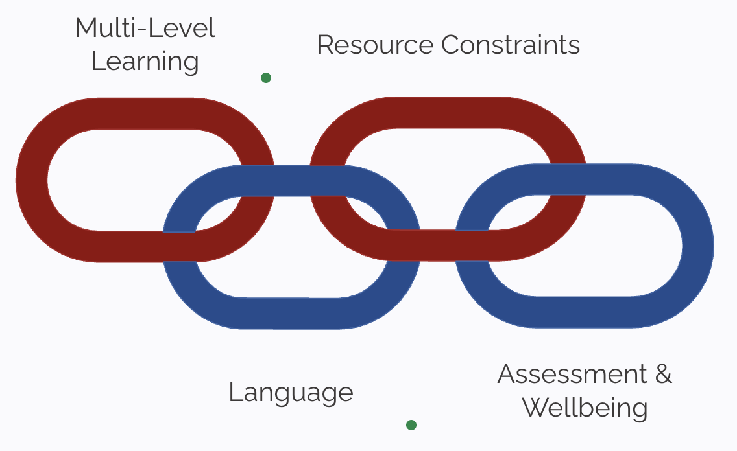
South African Mathematics Learning - Key Context

Slide 14
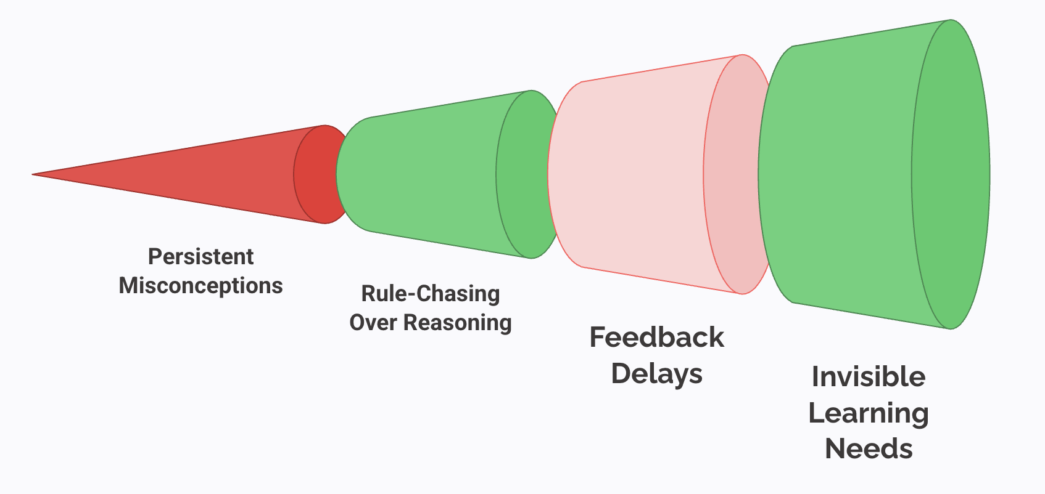
Classroom Pain Points We Can Fix

Slide 15
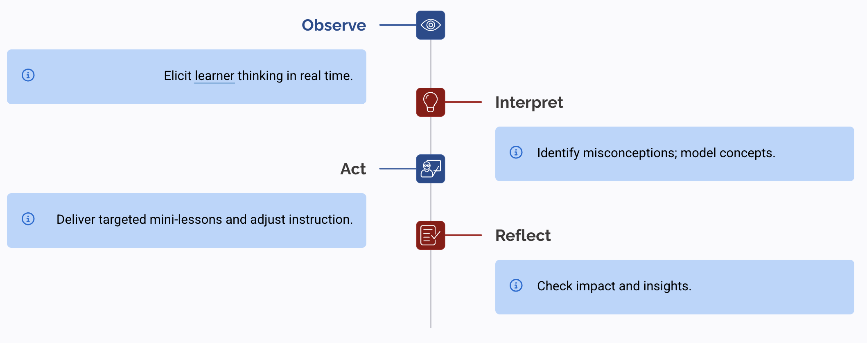
What Is a Good Teacher? The Core Loop

Slide 16
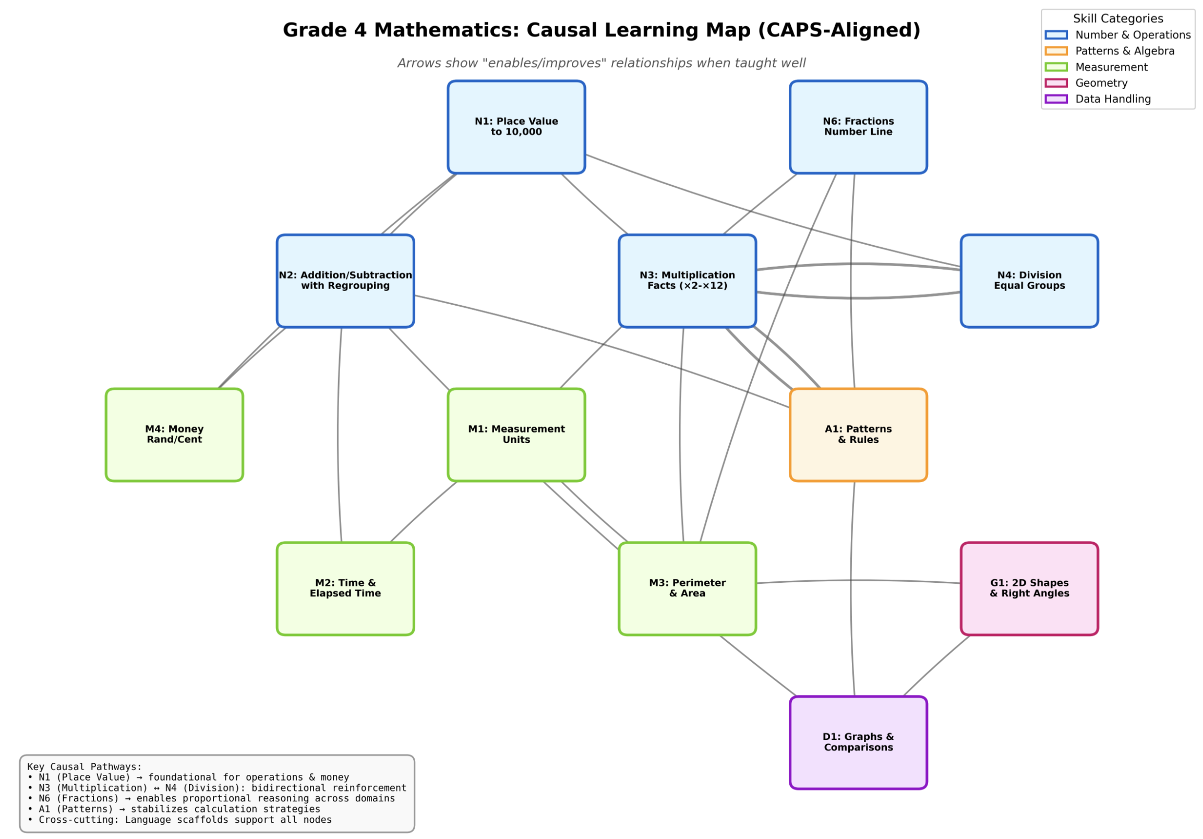

Slide 17
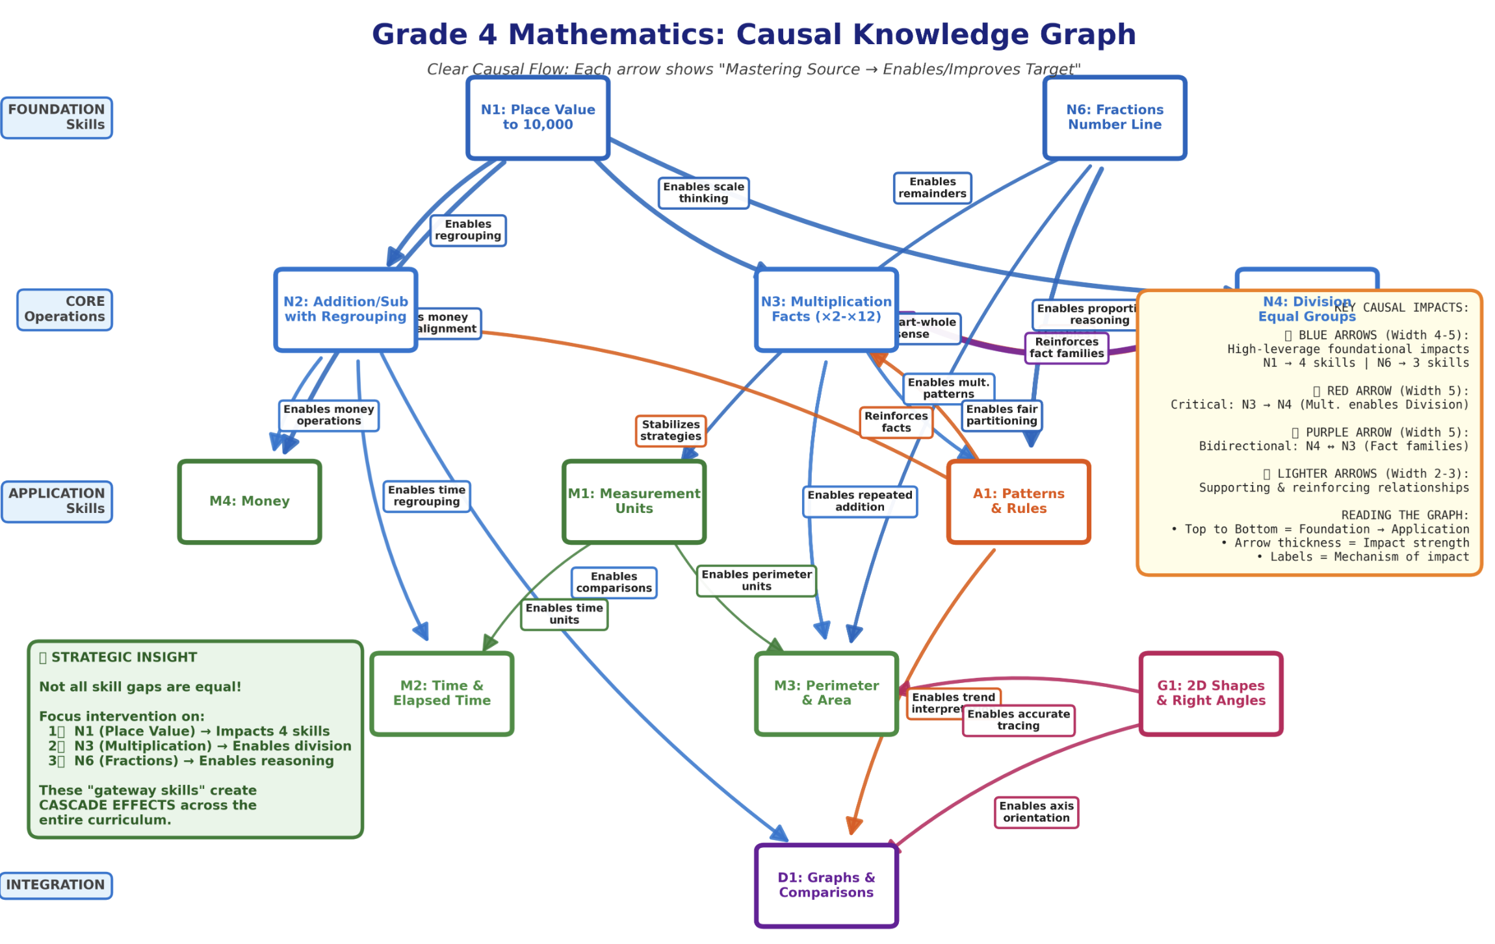

Slide 18
What are we doing?
Develop knowledge graphs
Develop causal model
Continues platform improvement (CICD)

Slide 19
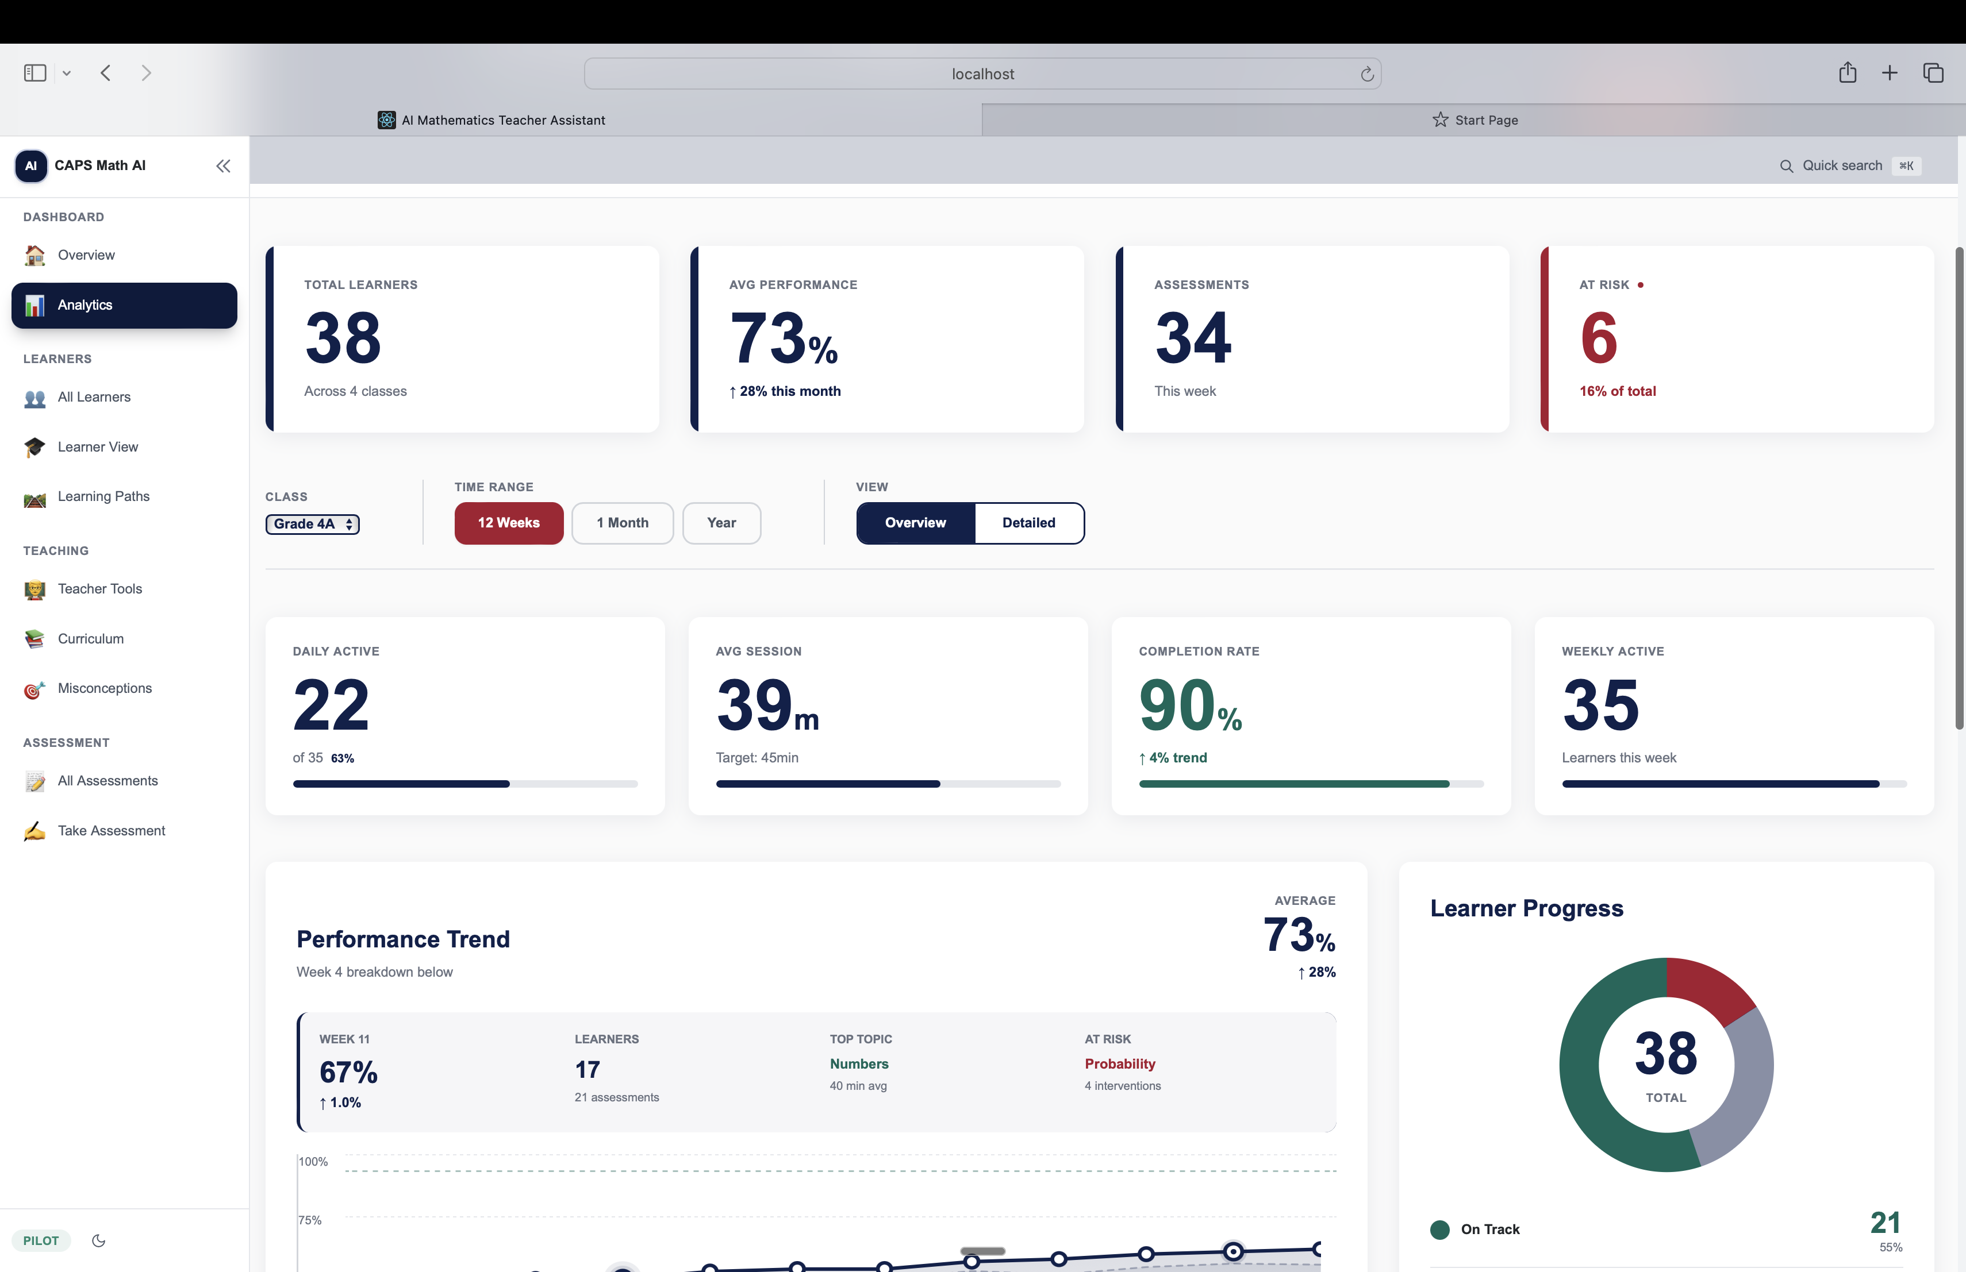

Slide 20
